Slide 1
Predicting Customer Life Time Value
Customer Relationship Management

Slide 2
Objective
This is the data of an automobile insurance company. Our aim is to examine which attributes influence higher customer life time value. CLV is the total revenue that the client will derive from their entire relationship with a customer .
Here we can see that as the name suggests we need to predict the customer lifetime value for each customer so as to make sure how much benefit each customer can repay to the company in exchange of the benefits he or she receives

Slide 3
Approach
We propose a multiple linear regression model to find out how and why the clv gets influenced and how to tackle clv so that the company can benefit.
We start by taking clv as the dependent/target variable and the whole model based on this variable.

Slide 4
Basic exploration of data
There are 9134 observations with 24 variables
Independent variables are:
Customer
State
Response
Coverage
Education
Gender
EmploymentStatus
Income
Location Code
Monthly Premium Auto
Months Since Policy Inception
Number of Open Complaints
Policy Type
Months Since Last Claim
Policy
Sales Channel
Total Claim Amount
Renew Offer Type
Number of Policies
Vehicle Class
Vehicle Size

Slide 5
Basic Exploration of data
Customer Life Time Value is continuous variable
More of the variables are categorical variables
Customer i.e. the customer id is a unique number, should not be a indicator variable
Change the name of response variable as “clv”

Slide 6
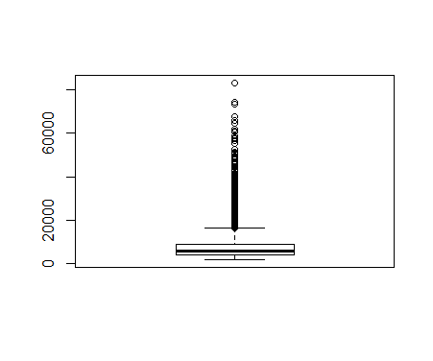
Outlier Treatment By Quantile Method
Need to analyze the distribution of clv using quantile method
Clv has outliers from 90% to 100%,which has been get rid of by restricting clv up to 36000

Slide 7
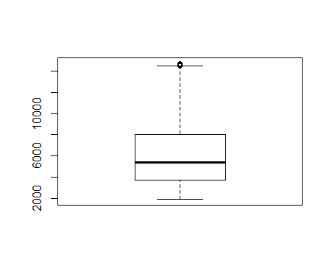
Outlier Treatment By Quantile Method
We are left with 9043 obs. With 24 variables. 91 values has been omitted.
Checking further any outlier presence on current data
0% to 90% shows consistent but after that up to 100%
is a huge leap
Considering up to 90% i.e. we restrict the data up to 14742
Now we have 8138 obs. with 24 variables

Slide 8
Data cleaning & manipulation
There is no missing value
Some redundant variables like Customer, State, and Effective to date has been removed
Finally we have left with 8138 obs. With 21 variables
We ran the model in R doing a linear regression having clv as the dependent variables as clv is continuous integer variable to predict.

Slide 9
Fitting the model
Split the dataset 70%-training data; 30%-test data
Building linear model on training data with 5696 obs. of 21 variables.
Iteration done by removing the insignificant variables on each step
Final Model with the significant variables are Coverage, EmploymentStatus(Unemployed), Monthly Premium Auto , Number of Open Complaints, Number of Policies, Renew Offer Type, Vehicle Class(SUV) ,which play a role in contributing to the prediction of clv.

Slide 10
Goodness of fit
R square: the percentage of explained variation as if all independent variables in the model affect the dependent variable.
Adjusted R-squared: the percentage of variation explained by only those independent variables that in reality affect the dependent variable
Higher R ^2 and Adj R^2 will give better model
Here R Square and Adjusted R square are on same range of 0.30, which is good according to the data set.

Slide 11
Assumption Diagonestics
Multicollinearity-There should be no correlation between two or more of the predictors
Test with VIF. Lower the VIF better the model is
vif should be less than 3
Here vif all the variables are less than 3
It fails to reject the null hypothesis
There is no multicollinearity

Slide 12
Assumption Diagnosis
Autocorrelation : Errors should be uncorrelated
Checking by Durbin Watson test
P value is very high i.e. 0.95
We reject the alternative hypothesis
No autocorrelation

Slide 13
Assumption Diagnosis
Heteroscedasticity: low error variance between independent and dependent variable
Breuch- Pegon test
P should be on higher side
Here p is very low, reject null hypothesis
Heteroscedasticity is there

Slide 14
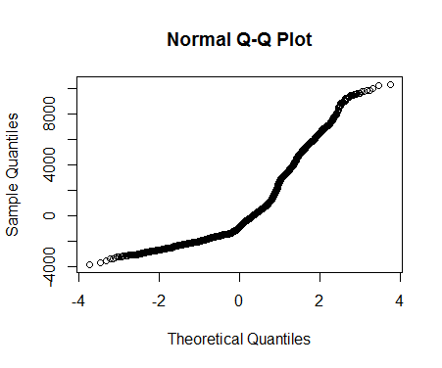
Assumption Diagnosis
Normality: Residuals should be normally distributed
Anderson Darling test and Pearson Chi-square test
P value should be on higher side
But here P is very less
Errors are not normally distributed

Slide 15
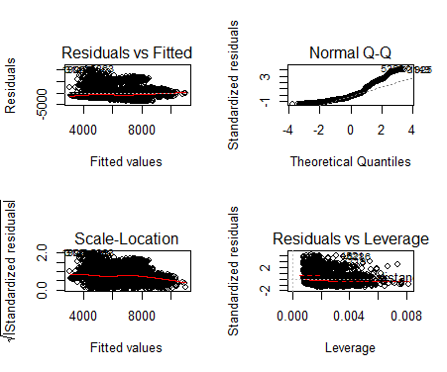
Actual vs. Predicted
Actuals and predicted values are more or less linearly related
But Residuals are not normally distributed in Q-Q plot

Slide 16
Actual vs. Predicted
Mean Absolute percentage error (MAPE): how much deviation is there between actuals and predicted.
Lower this value better will our model.
In this case MAPE is 35%.
Predict clv on test data on final model
Model p value and predictor’s p value are less than the significance level, so we know we have a statistically significant model.

Slide 17
Accuracy Measure of the Model
Simple correlation between the actuals and predicted values can be used as a form of accuracy measure
Here correlation between actual and predicted shown as 55%.
Mape is also 35%
According to structure of dataset it is considered as a good model

Slide 18
Conclusion
In all the model is a good model apart from a few of the assumptions not going in favour of the multiple linear regression model guidelines namely homoscedasticity and normality
Overall we can see that premium coverage, unemployed , Monthly Premium Auto, Number of Open Complaints, Number of Policies, Renew Offer Type and Vehicle Class of SUV affect the CLV and has major role behind the values it comes up to
As an auto insurance company the type of vehicle or size does not matter much
Mainly the unemployed people need the insurance more and thus will contribute more to the company

Slide 19
Business Recommendations
The agents should target mainly the customers who are unemployed and education does not matter here
Attention should be given equally to the premium customers as well as basic customers
The number of complaints should be reduced
The agents should start increasing their policy advertisement to the customers as the no. of policy affects the clv
Trying to reach out the customers with the more attractive offers at the time of renewal of insurance
Targeting the customers who are giving monthly premium having vehicle class suv.

